Slide 1
Database Management System (MDS 505)
Jagdish Bhatta
Jagdish Bhatta

Slide 2
Unit – 5.2
Concurrency Control Techniques
Jagdish Bhatta
Notes:
Jagidsh Bhatta

Slide 3
Concurrency Control
Generally, database system allows multiple transactions to run concurrently.
Concurrent execution of transaction in database system improves database system performance, reducing transaction waiting time to proceed. It improves resource utilization. But it may lead the database in inconsistent state due to interference among actions of concurrent transactions.
Concurrent execution of transaction in database system leads several concurrency control problems.
Jagdish Bhatta
Notes:
Jagidsh Bhatta

Slide 4
Purpose of Concurrency Control
To enforce isolation (through mutual exclusion) among conflicting transactions.
To preserve database consistency through consistency preserving execution of transactions.
To resolve read-write and write-write conflicts
Jagdish Bhatta
Notes:
Jagidsh Bhatta

Slide 5
Two-Phase Locking Techniques for Concurrency Control
Some of the main techniques used to control concurrent execution of transactions are based on the concept of locking data items.
A lock is a variable associated with a data item that describes the status of the item with respect to possible operations that can be applied to it. Generally, there is one lock for each data item in the database.
Locks are used as a means of synchronizing the access by concurrent transactions to the database items.
Jagdish Bhatta
Notes:
Jagidsh Bhatta

Slide 6
Two-Phase Locking Techniques for Concurrency Control
Types of Locks and System Lock Tables
Several types of locks are used in concurrency control. To introduce locking concepts gradually, there are binary locks, which are simple but are also too restrictive for database concurrency control purposes and so are not used much.
Another types of locks are shared/exclusive locks—also known as read/write locks—which provide more general locking capabilities and are used in database locking schemes.
Jagdish Bhatta
Notes:
Jagidsh Bhatta

Slide 7
Two-Phase Locking Techniques for Concurrency Control
Types of Locks and System Lock Tables
Binary Locks. A binary lock can have two states or values: locked and unlocked (or 1 and 0, for simplicity). A distinct lock is associated with each database item X. If the value of the lock on X is 1, item X cannot be accessed by a database operation that requests the item. If the value of the lock on X is 0, the item can be accessed when requested, and the lock value is changed to 1. We refer to the current value (or state) of the lock associated with item X as lock(X).
Jagdish Bhatta
Notes:
Jagidsh Bhatta

Slide 8
Two-Phase Locking Techniques for Concurrency Control
Types of Locks and System Lock Tables
Two operations, lock_item and unlock_item, are used with binary locking. A transaction requests access to an item X by first issuing a lock_item(X) operation. If LOCK(X) = 1, the transaction is forced to wait. If LOCK(X) = 0, it is set to 1 (the transaction locks the item) and the transaction is allowed to access item X. When the transaction is through using the item, it issues an unlock_item(X) operation, which sets LOCK(X) back to 0 (unlocks the item) so that X may be accessed by other transactions. Hence, a binary lock enforces mutual exclusion on the data item.
Jagdish Bhatta
Notes:
Jagidsh Bhatta

Slide 9
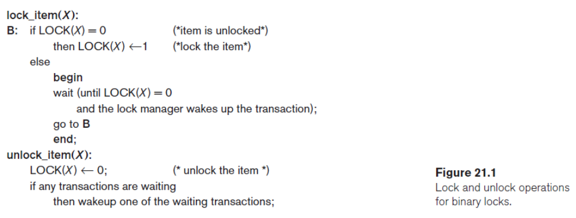
Two-Phase Locking Techniques for Concurrency Control
Types of Locks and System Lock Tables
Jagdish Bhatta
Notes:
Jagidsh Bhatta

Slide 10
Two-Phase Locking Techniques for Concurrency Control
Types of Locks and System Lock Tables
Notice that the lock_item and unlock_item operations must be implemented as indivisible units (known as critical sections in operating systems); that is, no interleaving should be allowed once a lock or unlock operation is started until the operation terminates or the transaction waits. In Figure 21.1 in previous slide, the wait command within the lock_item(X) operation is usually implemented by putting the transaction in a waiting queue for item X until X is unlocked and the transaction can be granted access to it. Other transactions that also want to access X are placed in the same queue. Hence, the wait command is considered to be outside the lock_item operation.
Jagdish Bhatta
Notes:
Jagidsh Bhatta

Slide 11
Two-Phase Locking Techniques for Concurrency Control
Types of Locks and System Lock Tables
It is simple to implement a binary lock; all that is needed is a binary-valued variable, LOCK, associated with each data item X in the database. In its simplest form, each lock can be a record with three fields: <Data_item_name, LOCK, Locking_transaction> plus a queue for transactions that are waiting to access the item. The system needs to maintain only these records for the items that are currently locked in a lock table, which could be organized as a hash file on the item name. Items not in the lock table are considered to be unlocked. The DBMS has a lock manager subsystem to keep track of and control access to locks.
Jagdish Bhatta
Notes:
Jagidsh Bhatta

Slide 12
Two-Phase Locking Techniques for Concurrency Control
Types of Locks and System Lock Tables
If the simple binary locking scheme described here is used, every transaction must obey the following rules:
  A transaction T must issue the operation lock_item(X) before any read_item(X) or write_item(X) operations are performed in T.
  A transaction T must issue the operation unlock_item(X) after all read_item(X) and write_item(X) operations are completed in T.
  A transaction T will not issue a lock_item(X) operation if it already holds the lock on item X.1
  A transaction T will not issue an unlock_item(X) operation unless it already holds the lock on item X.
These rules can be enforced by the lock manager module of the DBMS. Between the lock_item(X) and unlock_item(X) operations in transaction T, T is said to hold the lock on item X. At most one transaction can hold the lock on a particular item. Thus no two transactions can access the same item concurrently.
Jagdish Bhatta
Notes:
Jagidsh Bhatta

Slide 13
Two-Phase Locking Techniques for Concurrency Control
Types of Locks and System Lock Tables
Shared/Exclusive (or Read/Write) Locks. The preceding binary locking scheme is too restrictive for database items because at most one transaction can hold a lock on a given item.
We should allow several transactions to access the same item X if they all access X for reading purposes only. This is because read operations on the same item by different transactions are not conflicting. However, if a transaction is to write an item X, it must have exclusive access to X.
For this purpose, a different type of lock, called a multiple-mode lock, is used. In this scheme—called shared/exclusive or read/write locks—there are three locking operations: read_lock(X), write_lock(X), and unlock(X). A lock associated with an item X, LOCK(X), now has three possible states: read-locked, write-locked, or unlocked. A read-locked item is also called share-locked because other transactions are allowed to read the item, whereas a write-locked item is called exclusive-locked because a single transaction exclusively holds the lock on the item.
Jagdish Bhatta
Notes:
Jagidsh Bhatta

Slide 14
Two-Phase Locking Techniques for Concurrency Control
Types of Locks and System Lock Tables
One method for implementing the preceding operations on a read/write lock is to keep track of the number of transactions that hold a shared (read) lock on an item in the lock table, as well as a list of transaction ids that hold a shared lock.
Each record in the lock table will have four fields: <Data_item_name, LOCK, No_of_reads, Locking_transaction(s)>. The system needs to maintain lock records only for locked items in the lock table. The value (state) of LOCK is either readlocked or write-locked, suitably coded (if we assume no records are kept in the lock table for unlocked items). If LOCK(X) = write-locked, the value of locking_transaction(s) is a single transaction that holds the exclusive (write) lock on X. If LOCK(X)=read-locked, the value of locking transaction(s) is a list of one or more transactions that hold the shared (read) lock on X.
Jagdish Bhatta
Notes:
Jagidsh Bhatta

Slide 15
Two-Phase Locking Techniques for Concurrency Control
Types of Locks and System Lock Tables
The three operations read_lock(X), write_lock(X), and unlock(X) are described in Figure 21.2.,in next slide. As before, each of the three locking operations should be considered indivisible; no interleaving should be allowed once one of the operations is started until either the operation terminates by granting the lock or the transaction is placed in a waiting queue for the item.
Jagdish Bhatta
Notes:
Jagidsh Bhatta

Slide 16
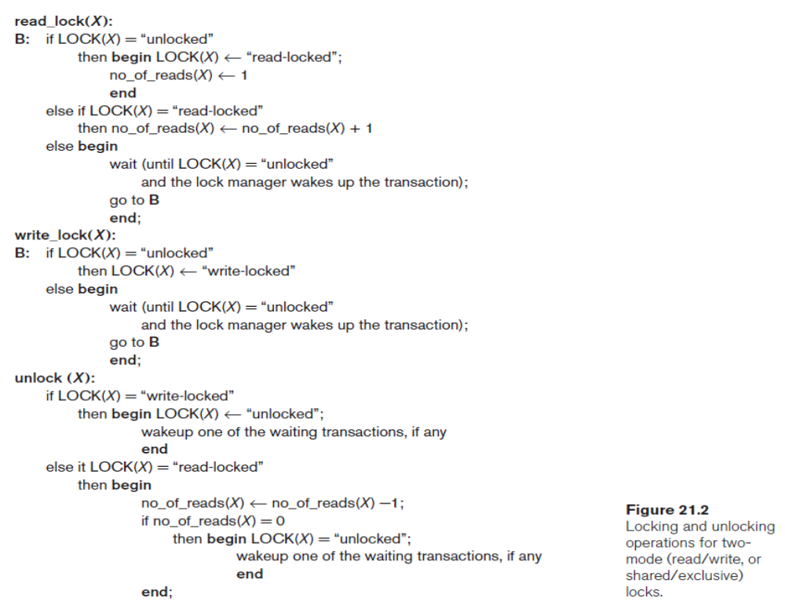
Two-Phase Locking Techniques for Concurrency Control
Jagdish Bhatta
Notes:
Jagidsh Bhatta

Slide 17
Two-Phase Locking Techniques for Concurrency Control
Types of Locks and System Lock Tables
When we use the shared/exclusive locking scheme, the system must enforce the following rules:
  A transaction T must issue the operation read_lock(X) or write_lock(X) before any read_item(X) operation is performed in T.
  A transaction T must issue the operation write_lock(X) before any write_item(X) operation is performed in T.
  A transaction T must issue the operation unlock(X) after all read_item(X) and write_item(X) operations are completed in T.
  A transaction T will not issue a read_lock(X) operation if it already holds a read (shared) lock or a write (exclusive) lock on item X. This rule may be relaxed for downgrading of locks, as we discuss shortly.
  A transaction T will not issue a write_lock(X) operation if it already holds a read (shared) lock or write (exclusive) lock on item X. This rule may also be relaxed for upgrading of locks, as we discuss shortly.
  A transaction T will not issue an unlock(X) operation unless it already holds a read (shared) lock or a write (exclusive) lock on item X.
Jagdish Bhatta
Notes:
Jagidsh Bhatta

Slide 18
Two-Phase Locking Techniques for Concurrency Control
Types of Locks and System Lock Tables
Conversion (Upgrading, Downgrading) of Locks. It is desirable to relax conditions 4 and 5 in the preceding list in order to allow lock conversion; that is, a transaction that already holds a lock on item X is allowed under certain conditions to convert the lock from one locked state to another. For example, it is possible for a transaction T to issue a read_lock(X) and then later to upgrade the lock by issuing a write_lock(X) operation. If T is the only transaction holding a read lock on X at the time it issues the write_lock(X) operation, the lock can be upgraded; otherwise, the transaction must wait. It is also possible for a transaction T to issue a write_lock(X) and then later to downgrade the lock by issuing a read_lock(X) operation. When upgrading and downgrading of locks is used, the lock table must include transaction identifiers in the record structure for each lock (in the locking_transaction(s) field) to store the information on which transactions hold locks on the item.
Jagdish Bhatta
Notes:
Jagidsh Bhatta

Slide 19
Two-Phase Locking Techniques for Concurrency Control
Types of Locks and System Lock Tables
Using binary locks or read/write locks in transactions, as described earlier, does not guarantee serializability of schedules on its own. Figure 21.3, in the next slide, shows an example where the preceding locking rules are followed but a nonserializable schedule may result. This is because in Figure 21.3(a) the items Y in T1 and X in T2 were unlocked too early. This allows a schedule such as the one shown in Figure 21.3(c) to occur, which is not a serializable schedule and hence gives incorrect results. To guarantee serializability, we must follow an additional protocol concerning the positioning of locking and unlocking operations in every transaction.
Jagdish Bhatta
Notes:
Jagidsh Bhatta

Slide 20
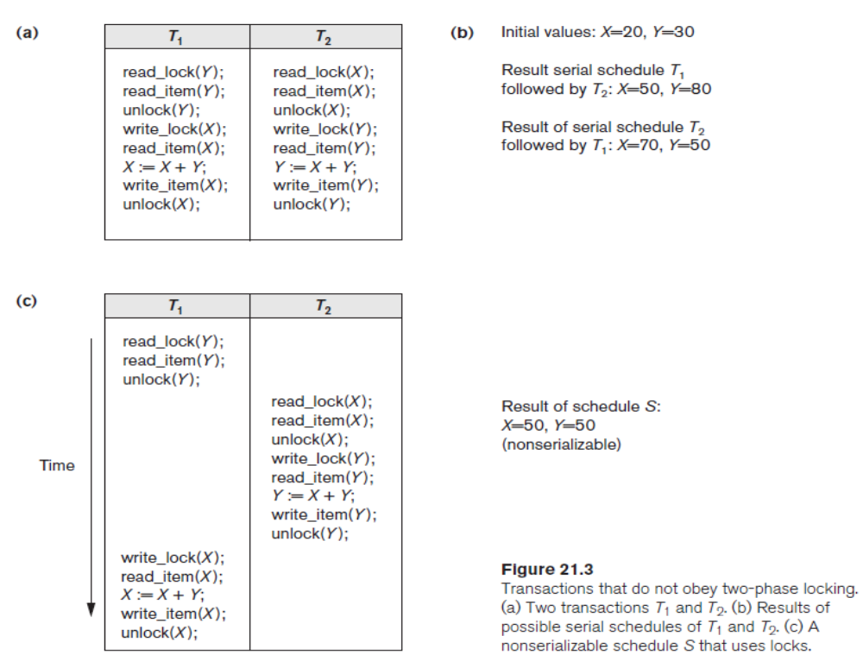
Two-Phase Locking Techniques for Concurrency Control
Types of Locks and System Lock Tables
Jagdish Bhatta
Notes:
Jagidsh Bhatta

Slide 21
Two-Phase Locking Techniques for Concurrency Control
Guaranteeing Serializability by Two-Phase Locking
A transaction is said to follow the two-phase locking protocol, often known as basic 2PL, if all locking operations (read_lock, write_lock) precede the first unlock operation in the transaction. Such a transaction can be divided into two phases: an expanding or growing (first) phase, during which new locks on items can be acquired but none can be released; and a shrinking (second) phase, during which existing locks can be released but no new locks can be acquired. If lock conversion is allowed, then upgrading of locks (from read-locked to write-locked) must be done during the expanding phase, and downgrading of locks (from write-locked to read-locked) must be done in the shrinking phase.
Jagdish Bhatta
Notes:
Jagidsh Bhatta

Slide 22
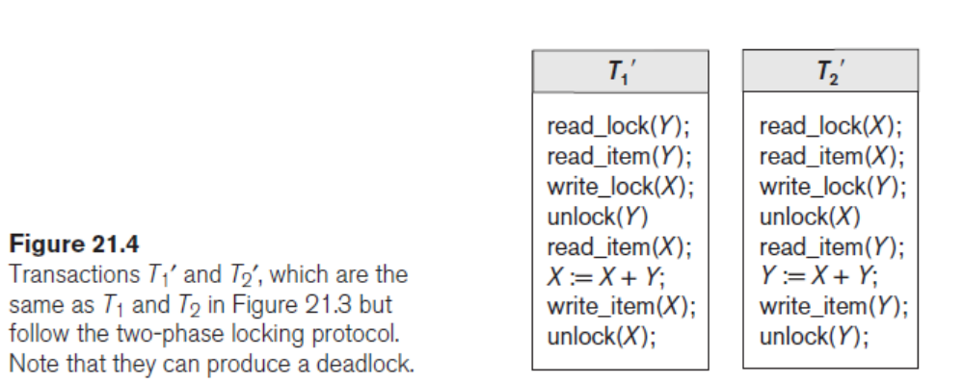
Two-Phase Locking Techniques for Concurrency Control
Guaranteeing Serializability by Two-Phase Locking
Jagdish Bhatta
Notes:
Jagidsh Bhatta

Slide 23
Two-Phase Locking Techniques for Concurrency Control
Guaranteeing Serializability by Two-Phase Locking
It can be proved that, if every transaction in a schedule follows the two-phase locking protocol, the schedule is guaranteed to be serializable, obviating the need to test for serializability of schedules. The locking protocol, by enforcing two-phase locking rules, also enforces serializability.
Two-phase locking may limit the amount of concurrency that can occur in a schedule because a transaction T may not be able to release an item X after it is through using it if T must lock an additional item Y later; or, conversely, T must lock the additional item Y before it needs it so that it can release X. Hence, X must remain locked by T until all items that the transaction needs to read or write have been locked; only then can X be released by T. Meanwhile, another transaction seeking to access X may be forced to wait, even though T is done with X; conversely, if Y is locked earlier than it is needed, another transaction seeking to access Y is forced to wait even though T is not using Y yet. This is the price for guaranteeing serializability of all schedules without having to check the schedules themselves.
Jagdish Bhatta
Notes:
Jagidsh Bhatta

Slide 24
Two-Phase Locking Techniques for Concurrency Control
Basic, Conservative, Strict, and Rigorous Two-Phase Locking.
There are a number of variations of two-phase locking (2PL). The technique just described is known as basic 2PL. A variation known as conservative 2PL (or static 2PL) requires a transaction to lock all the items it accesses before the transaction begins execution, by predeclaring its read-set and write-set.
The read-set of a transaction is the set of all items that the transaction reads, and the write-set is the set of all items that it writes. If any of the predeclared items needed cannot be locked, the transaction does not lock any item; instead, it waits until all the items are available for locking. Conservative 2PL is a deadlock-free protocol. However, it is difficult to use in practice because of the need to predeclare the read-set and writeset, which is not possible in some situations.
Jagdish Bhatta
Notes:
Jagidsh Bhatta

Slide 25
Two-Phase Locking Techniques for Concurrency Control
Basic, Conservative, Strict, and Rigorous Two-Phase Locking.
In practice, the most popular variation of 2PL is strict 2PL, which guarantees strict schedules. In this variation, a transaction T does not release any of its exclusive (write) locks until after it commits or aborts. Hence, no other transaction can read or write an item that is written by T unless T has committed, leading to a strict schedule for recoverability. Strict 2PL is not deadlock-free.
A more restrictive variation of strict 2PL is rigorous 2PL, which also guarantees strict schedules. In this variation, a transaction T does not release any of its locks (exclusive or shared) until after it commits or aborts, and so it is easier to implement than strict 2PL.
Jagdish Bhatta
Notes:
Jagidsh Bhatta

Slide 26
Two-Phase Locking Techniques for Concurrency Control
Basic, Conservative, Strict, and Rigorous Two-Phase Locking.
Notice the difference between strict and rigorous 2PL: the former holds write-locks until it commits, whereas the latter holds all locks (read and write). Also, the difference between conservative and rigorous 2PL is that the former must lock all its items before it starts, so once the transaction starts it is in its shrinking phase; the latter does not unlock any of its items until after it terminates (by committing or aborting), so the transaction is in its expanding phase until it ends.
Jagdish Bhatta
Notes:
Jagidsh Bhatta

Slide 27
Two-Phase Locking Techniques for Concurrency Control
Basic, Conservative, Strict, and Rigorous Two-Phase Locking.
Usually the concurrency control subsystem itself is responsible for generating the read_lock and write_lock requests.
For example, suppose the system is to enforce the strict 2PL protocol. Then, whenever transaction T issues a read_item(X), the system calls the read_lock(X) operation on behalf of T. If the state of LOCK(X) is write_locked by some other transaction T′, the system places T in the waiting queue for item X; otherwise, it grants the read_lock(X) request and permits the read_item(X) operation of T to execute.
On the other hand, if transaction T issues a write_item(X), the system calls the write_lock(X) operation on behalf of T. If the state of LOCK(X) is write_locked or read_locked by some other transaction T′, the system places T in the waiting queue for item X; if the state of LOCK(X) is read_locked and T itself is the only transaction holding the read lock on X, the system upgrades the lock to write_locked and permits the write_item(X) operation by T. Finally, if the state of LOCK(X) is unlocked, the system grants the write_lock(X) request and permits the write_item(X) operation to execute. After each action, the system must update its lock table appropriately.
Jagdish Bhatta
Notes:
Jagidsh Bhatta

Slide 28
Two-Phase Locking Techniques for Concurrency Control
Basic, Conservative, Strict, and Rigorous Two-Phase Locking.
Locking is generally considered to have a high overhead, because every read or write operation is preceded by a system locking request. The use of locks can also cause two additional problems: deadlock and starvation
Jagdish Bhatta
Notes:
Jagidsh Bhatta

Slide 29
Two-Phase Locking Techniques for Concurrency Control
Dealing with Deadlock and Starvation
Deadlock occurs when each transaction T in a set of two or more transactions is waiting for some item that is locked by some other transaction T′ in the set. Hence, each transaction in the set is in a waiting queue, waiting for one of the other transactions in the set to release the lock on an item. But because the other transaction is also waiting, it will never release the lock. A simple example is shown in figure 21.5(a), in the next slide, where the two transactions T1′ and T2′ are deadlocked in a partial schedule; T1′ is in the waiting queue for X, which is locked by T2′, whereas T2′ is in the waiting queue for Y, which is locked by T1′. Meanwhile, neither T1′ nor T2′ nor any other transaction can access items X and Y.
Jagdish Bhatta
Notes:
Jagidsh Bhatta

Slide 30
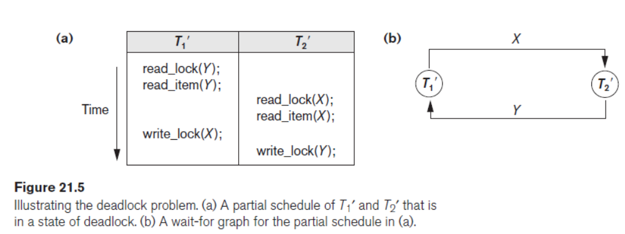
Two-Phase Locking Techniques for Concurrency Control
Dealing with Deadlock and Starvation
Jagdish Bhatta
Notes:
Jagidsh Bhatta

Slide 31
Two-Phase Locking Techniques for Concurrency Control
Deadlock Prevention Protocols
One way to prevent deadlock is to use a deadlock prevention protocol. One deadlock prevention protocol, which is used in conservative two-phase locking, requires that every transaction lock all the items it needs in advance (which is generally not a practical assumption)—if any of the items cannot be obtained, none of the items are locked. Rather, the transaction waits and then tries again to lock all the items it needs. Obviously, this solution further limits concurrency.
A second protocol, which also limits concurrency, involves ordering all the items in the database and making sure that a transaction that needs several items will lock them according to that order. This requires that the programmer (or the system) is aware of the chosen order of the items, which is also not practical in the database context.
Jagdish Bhatta
Notes:
Jagidsh Bhatta

Slide 32
Two-Phase Locking Techniques for Concurrency Control
Deadlock Prevention Protocols
A number of other deadlock prevention schemes have been proposed that make a decision about what to do with a transaction involved in a possible deadlock situation: Should it be blocked and made to wait or should it be aborted, or should the transaction preempt and abort another transaction? Some of these techniques use the concept of transaction timestamp TS(T′), which is a unique identifier assigned to each transaction.
The timestamps are typically based on the order in which transactions are started; hence, if transaction T1 starts before transaction T2, then TS(T1) < TS(T2). Notice that the older transaction (which starts first) has the smaller timestamp value. Two schemes that prevent deadlock are called wait-die and wound-wait.
Jagdish Bhatta
Notes:
Jagidsh Bhatta

Slide 33
Two-Phase Locking Techniques for Concurrency Control
Deadlock Prevention Protocols
Suppose that transaction Ti tries to lock an item X but is not able to because X is locked by some other transaction Tj with a conflicting lock. The rules followed by these schemes are:
  Wait-die. If TS(Ti) < TS(Tj), then (Ti older than Tj) Ti is allowed to wait; otherwise (Ti younger than Tj) abort Ti (Ti dies) and restart it later with the same timestamp.
  Wound-wait. If TS(Ti) < TS(Tj), then (Ti older than Tj) abort Tj (Ti wounds Tj) and restart it later with the same timestamp; otherwise (Ti younger than Tj) Ti is allowed to wait.
Jagdish Bhatta
Notes:
Jagidsh Bhatta

Slide 34
Two-Phase Locking Techniques for Concurrency Control
Deadlock Prevention Protocols
In wait-die, an older transaction is allowed to wait for a younger transaction, whereas a younger transaction requesting an item held by an older transaction is aborted and restarted. The wound-wait approach does the opposite: A younger transaction is allowed to wait for an older one, whereas an older transaction requesting an item held by a younger transaction preempts the younger transaction by aborting it. Both schemes end up aborting the younger of the two transactions (the transaction that started later) that may be involved in a deadlock, assuming that this will waste less processing. It can be shown that these two techniques are deadlock-free, since in waitdie, transactions only wait for younger transactions so no cycle is created. Similarly, in wound-wait, transactions only wait for older transactions so no cycle is created. However, both techniques may cause some transactions to be aborted and restarted needlessly, even though those transactions may never actually cause a deadlock.
Jagdish Bhatta
Notes:
Jagidsh Bhatta

Slide 35
Two-Phase Locking Techniques for Concurrency Control
Deadlock Prevention Protocols
Another group of protocols that prevent deadlock do not require timestamps. These include the no waiting (NW) and cautious waiting (CW) algorithms.
In the no waiting algorithm, if a transaction is unable to obtain a lock, it is immediately aborted and then restarted after a certain time delay without checking whether a deadlock will actually occur or not. In this case, no transaction ever waits, so no deadlock will occur. However, this scheme can cause transactions to abort and restart needlessly.
Jagdish Bhatta
Notes:
Jagidsh Bhatta

Slide 36
Two-Phase Locking Techniques for Concurrency Control
Deadlock Prevention Protocols
The cautious waiting algorithm was proposed to try to reduce the number of needless aborts/restarts. Suppose that transaction Ti tries to lock an item X but is not able to do so because X is locked by some other transaction Tj with a conflicting lock. The cautious waiting rule is as follows:
  Cautious waiting. If Tj is not blocked (not waiting for some other locked item), then Ti is blocked and allowed to wait; otherwise abort Ti.
It can be shown that cautious waiting is deadlock-free, because no transaction will ever wait for another blocked transaction. By considering the time b(T) at which each blocked transaction T was blocked, if the two transactions Ti and Tj above both become blocked and Ti is waiting for Tj, then b(Ti) < b(Tj), since Ti can only wait for Tj at a time when Tj is not blocked itself. Hence, the blocking times form a total ordering on all blocked transactions, so no cycle that causes deadlock can occur.
Jagdish Bhatta
Notes:
Jagidsh Bhatta

Slide 37
Two-Phase Locking Techniques for Concurrency Control
Deadlock Detection
An alternative approach to dealing with deadlock is deadlock detection, where the system checks if a state of deadlock actually exists.
This solution is attractive if we know there will be little interference among the transactions—that is, if different transactions will rarely access the same items at the same time. This can happen if the transactions are short and each transaction locks only a few items, or if the transaction load is light. On the other hand, if transactions are long and each transaction uses many items, or if the transaction load is heavy, it may be advantageous to use a deadlock prevention scheme.
Jagdish Bhatta
Notes:
Jagidsh Bhatta

Slide 38
Two-Phase Locking Techniques for Concurrency Control
Deadlock Detection
A simple way to detect a state of deadlock is for the system to construct and maintain a wait-for graph. One node is created in the wait-for graph for each transaction that is currently executing. Whenever a transaction Ti is waiting to lock an item X that is currently locked by a transaction Tj, a directed edge (Ti → Tj) is created in the wait-for graph. When Tj releases the lock(s) on the items that Ti was waiting for, the directed edge is dropped from the wait-for graph.
We have a state of deadlock if and only if the wait-for graph has a cycle. One problem with this approach is the matter of determining when the system should check for a deadlock. One possibility is to check for a cycle every time an edge is added to the wait for graph, but this may cause excessive overhead. Criteria such as the number of currently executing transactions or the period of time several transactions have been waiting to lock items may be used instead to check for a cycle.
Jagdish Bhatta
Notes:
Jagidsh Bhatta

Slide 39
Two-Phase Locking Techniques for Concurrency Control
Deadlock Detection
Jagdish Bhatta
Notes:
Jagidsh Bhatta

Slide 40
Two-Phase Locking Techniques for Concurrency Control
Deadlock Detection
If the system is in a state of deadlock, some of the transactions causing the deadlock must be aborted. Choosing which transactions to abort is known as victim selection. The algorithm for victim selection should generally avoid selecting transactions that have been running for a long time and that have performed many updates, and it should try instead to select transactions that have not made many changes (younger transactions).
Jagdish Bhatta
Notes:
Jagidsh Bhatta

Slide 41
Two-Phase Locking Techniques for Concurrency Control
Timeouts
Another simple scheme to deal with deadlock is the use of timeouts. This method is practical because of its low overhead and simplicity. In this method, if a transaction waits for a period longer than a system-defined timeout period, the system assumes that the transaction may be deadlocked and aborts it—regardless of whether a deadlock actually exists.
Jagdish Bhatta
Notes:
Jagidsh Bhatta

Slide 42
Two-Phase Locking Techniques for Concurrency Control
Starvation
Another problem that may occur when we use locking is starvation, which occurs when a transaction cannot proceed for an indefinite period of time while other transactions in the system continue normally. This may occur if the waiting scheme for locked items is unfair in that it gives priority to some transactions over others. One solution for starvation is to have a fair waiting scheme, such as using a first-come-first-served queue; transactions are enabled to lock an item in the order in which they originally requested the lock. Another scheme allows some transactions to have priority over others but increases the priority of a transaction the longer it waits, until it eventually gets the highest priority and proceeds.
Jagdish Bhatta
Notes:
Jagidsh Bhatta

Slide 43
Two-Phase Locking Techniques for Concurrency Control
Starvation
Starvation can also occur because of victim selection if the algorithm selects the same transaction as victim repeatedly, thus causing it to abort and never finish execution. The algorithm can use higher priorities for transactions that have been aborted multiple times to avoid this problem. The wait-die and wound-wait schemes discussed previously avoid starvation, because they restart a transaction that has been aborted with its same original timestamp, so the possibility that the same transaction is aborted repeatedly is slim.
Jagdish Bhatta
Notes:
Jagidsh Bhatta

Slide 44
Concurrency Control Based on Timestamp Ordering
The use of locking, combined with the 2PL protocol, guarantees serializability of schedules. The serializable schedules produced by 2PL have their equivalent serial schedules based on the order in which executing transactions lock the items they acquire. If a transaction needs an item that is already locked, it may be forced to wait until the item is released. Some transactions may be aborted and restarted because of the deadlock problem. A different approach to concurrency control involves using transaction timestamps to order transaction execution for an equivalent serial schedule.
Jagdish Bhatta
Notes:
Jagidsh Bhatta

Slide 45
Concurrency Control Based on Timestamp Ordering
Timestamps: A timestamp is a unique identifier created by the DBMS to identify a transaction. Typically, timestamp values are assigned in the order in which the transactions are submitted to the system, so a timestamp can be thought of as the transaction start time. We will refer to the timestamp of transaction T as TS(T).
Concurrency control techniques based on timestamp ordering do not use locks; hence, deadlocks cannot occur.
Timestamps can be generated in several ways. One possibility is to use a counter that is incremented each time its value is assigned to a transaction. The transaction timestamps are numbered 1, 2, 3, … in this scheme. A computer counter has a finite maximum value, so the system must periodically reset the counter to zero when no transactions are executing for some short period of time. Another way to implement timestamps is to use the current date/time value of the system clock and ensure that no two timestamp values are generated during the same tick of the clock.
Jagdish Bhatta
Notes:
Jagidsh Bhatta

Slide 46
The Timestamp Ordering Algorithm for Concurrency Control
The idea for this scheme is to enforce the equivalent serial order on the transactions based on their timestamps. A schedule in which the transactions participate is then serializable, and the only equivalent serial schedule permitted has the transactions in order of their timestamp values. This is called timestamp ordering (TO). Notice how this differs from 2PL, where a schedule is serializable by being equivalent to some serial schedule allowed by the locking protocols. In timestamp ordering, however, the schedule is equivalent to the particular serial order corresponding to the order of the transaction timestamps.
The algorithm allows interleaving of transaction operations, but it must ensure that for each pair of conflicting operations in the schedule, the order in which the item is accessed must follow the timestamp order.
Jagdish Bhatta
Notes:
Jagidsh Bhatta

Slide 47
The Timestamp Ordering Algorithm for Concurrency Control
The algorithm associates with each database item X two timestamp (TS) values:
  read_TS(X): The read timestamp of item X is the largest timestamp among all the timestamps of transactions that have successfully read item X—that is, read_TS(X) = TS(T), where T is the youngest transaction that has read X successfully.
  write_TS(X): The write timestamp of item X is the largest of all the timestamps of transactions that have successfully written item X—that is, write_TS(X) = TS(T), where T is the youngest transaction that has written X successfully.
Jagdish Bhatta
Notes:
Jagidsh Bhatta

Slide 48
Multiversion Concurrency Control Techniques
These protocols for concurrency control keep copies of the old values of a data item when the item is updated (written); they are known as multiversion concurrency control because several versions (values) of an item are kept by the system.
When a transaction requests to read an item, the appropriate version is chosen to maintain the serializability of the currently executing schedule. One reason for keeping multiple versions is that some read operations that would be rejected in other techniques can still be accepted by reading an older version of the item to maintain serializability.
When a transaction writes an item, it writes a new version and the old version(s) of the item is retained. Some multiversion concurrency control algorithms use the concept of view serializability rather than conflict serializability.
Jagdish Bhatta
Notes:
Jagidsh Bhatta

Slide 49
Multiversion Concurrency Control Techniques
An obvious drawback of multiversion techniques is that more storage is needed to maintain multiple versions of the database items. In some cases, older versions can be kept in a temporary store. It is also possible that older versions may have to be maintained anyway—for example, for recovery purposes.
Some database applications may require older versions to be kept to maintain a history of the changes of data item values. The extreme case is a temporal database, which keeps track of all changes and the times at which they occurred. In such cases, there is no additional storage penalty for multiversion techniques, since older versions are already maintained.
Jagdish Bhatta
Notes:
Jagidsh Bhatta

